Slide 1
Ethics in Designing U IMPACTIFY
Group 10
Ankit Kundal
Jugal Shah
Khushal Paresh Thaker
Mina Armanyous
Manva Trivedi
Rahul Singh
Srimanth Vempati
Supervised by,
Kevin Brooks, Abhijit Rao and
In support with,
Ashraful Hasan,
CEO and Founder of Impactrio

Slide 2
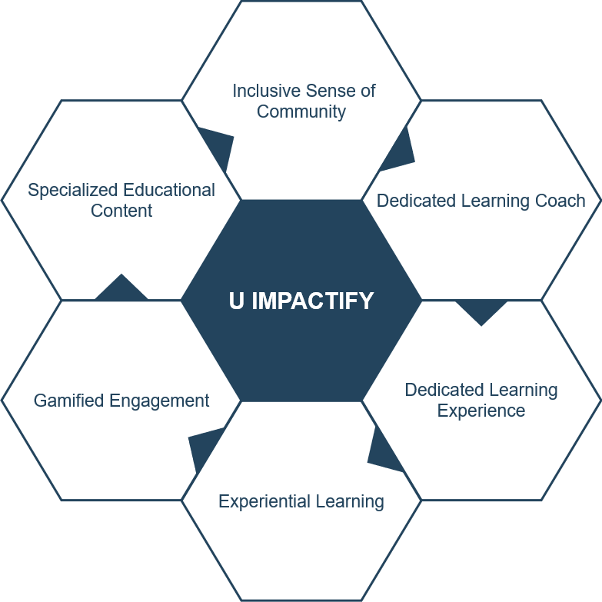
U IMPACTIFY
U Impactify is an e-Learning, e-Facilitation and e-coaching platform to encourage social development where social entrepreneurs can learn, grow and connect.
Ethical Design
Product Design
Development, Testing and Deployment

Slide 3
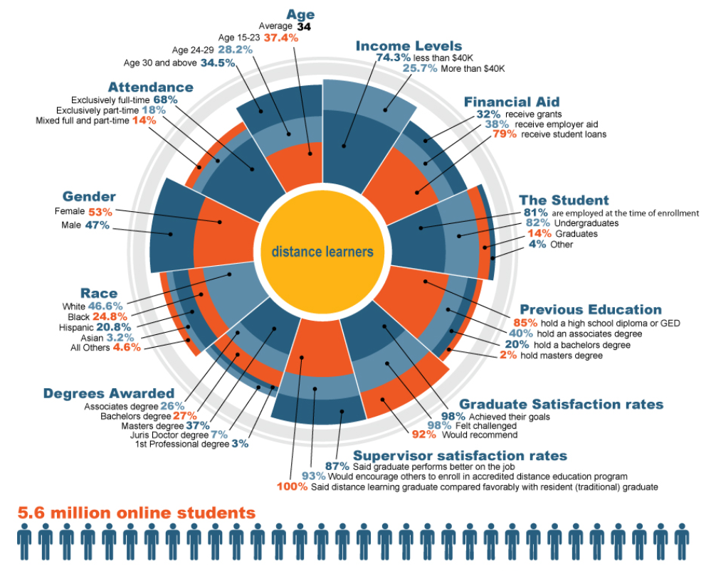
Key Facts
E-learning expend 90% less energy and 85% less CO2 outflows.
Social Entrepreneurs as such bring diversity as research reveals that 40% of the social enterprises in UK are led by women, out of which 31% comprise of black, Asian, or minority ethnic directors and 40% have directors with a disability.
62.4% of institutions developed by e-learning.
Market research by Impactrio, found (60%) networking is important.
Education Today recently posted an “Online Student Demographics” infographic that summarizes the studies of several leading organizations in e-learning. The gender make-up is 53% female and 47% male.
Pappas, Christopher. “Top 20 ELearning Statistics For 2019.” ELearning Industry, 22 Apr. 2020, elearningindustry.com/top-elearning-statistics-2019.
Sillis, Ben. “6 mindblowing social enterprise stats you need to know” Red Bull Gives You Wings - RedBull.com, Redbull, 2018, www.redbull.com/ca-en/social-enterprise-stats.
Hoffman, Jaimie. “Primary Menu.” Education and Careers, 2018, blog.classesandcareers.com/education/infographics/student-demographics-infographic/.

Slide 4
Key Stakeholders
Upper Management
Investers (if any)
Managers
Technology Experts
Authoring tool experts
Admins
Trainers/SMEs
Trainers
Narrators
Analytics Experts
Platform Experts
Course creators
Translators
(if any)
Students/
Enterpreneurs

Slide 5
Ethical Components
Participants
Diversity
Accessibility
Etiquettes
AI/Analytics
Trustfulness
Bias
E-Community
Copyright
Etiquettes
Upper Management
Data Management, security,
Ownership
Role of Knowing
Trainers
Professionalism
Accessibility
Privacy

Slide 6
Students
Privacy
Anonymity
Data Privacy
Diversity
Cultural
Learner
Geographical
Accessibility
Technical
Disabled
Etiquettes
Plagiarism
Behaviour

Slide 7
Suggested Solutions
Accessibility
Privacy
Diversity
Etiquettes
Attention
ADA¹ and UDL² compliance
PIPEDA³, FERPA⁴, etc.
Ethics by Design
Policies before hand
Gamified Approach and Micro learning, Following Human Design Guide by CHT⁵
¹ Americans with Disabilities act
² Universal Design for Learning
³ Personal Information Protection and Electronic Document Act
⁴ Family Education Rights and Privacy Act
⁵ Centre for Humane Technology

Slide 8

Upper Management
Data management and security
Data collection, retention and purpose
Data storage
Security
Data ownership
Outsourcing of data
Content owner
Role of knowing/obligation to act

Slide 9

Educators
Privacy
Problems:
Professionalism
Problems:
Accessibility
Problem:
Personal data tracking
Data unawareness (collection & usage)
Personal religious/political ideas put forth
Plagiarized work/ideas
Access to physically challenged

Slide 10
Educator (possible solutions)
Privacy
Solutions:
Professionalism
Solutions:
Accessibility
Solution:
Use transcripts for people with impaired hearing
Follow data privacy laws (FERPA, PIPEDA, etc.)
Video recordings (used as proof if needed)
Gamification approach
Content verification (peer review)

Slide 11
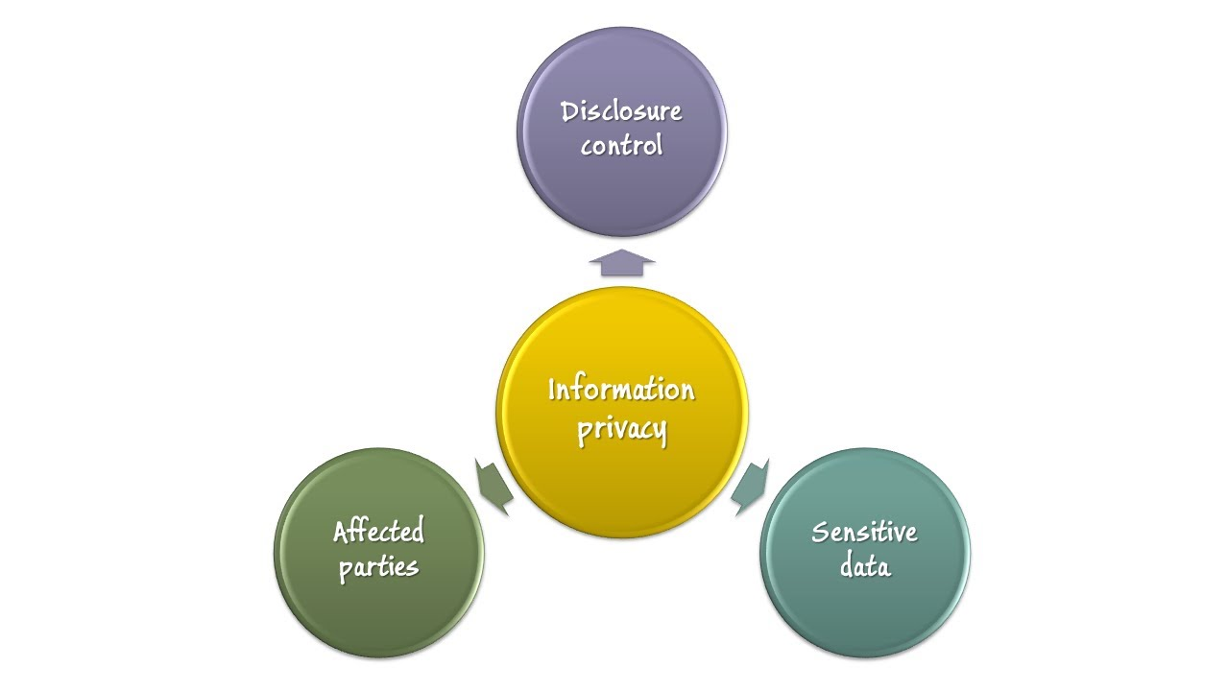
Community Ethical Issues
Technology is growing
Confidential data is abused and violated
Personal data is tracked
Gamification approach
Notify users
Secure data

Slide 12

Community Ethical Issues
Etiquette problems caused by using discussion forums, messages and mails
Can lead to disrespecting others and being uncivil
Use proper regulations to impose control

Slide 13

Community Ethical Issues
Digital Millennium Copyright Act (DMCA)
Create your own Intellectual Property
Copyright ownership of teaching and e-learning materials

Slide 14
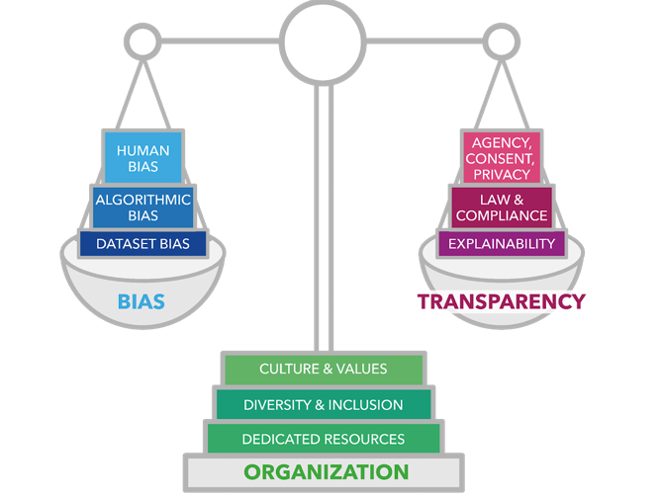
Artificial Intelligence

Slide 15
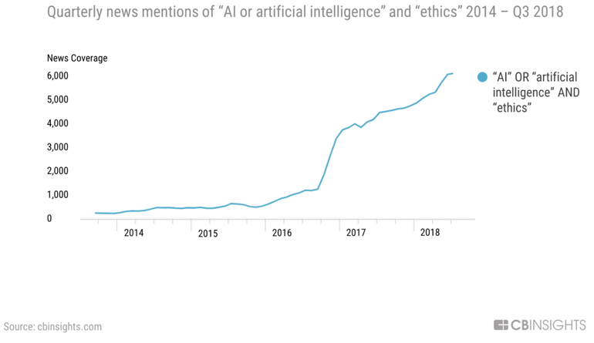
Privacy Trustfulness and Biasness
Personal privacy.
AI-based assessment?
AI-based learning?
AI mirrors our biases.
LACE Framework

Slide 16
Legal Issues
Plagiarism
Copy right
Content duplicity and stealing.
Algorithmic error.
Data Privacy and management.
Dissemination of knowledge with protection of the rights.
Intellectual property and copy rights.
Algorithms
Idea Stealing
Privacy Laws
Fair Use
Copy Protection
Jocoy, Christine L., and David DiBiase. "Plagiarism by adult learners online: A case study in detection and remediation." The International Review of Research in Open and Distributed Learning 7, no. 1 (2006).

Slide 17





Legal Issues
Plagiarism
Content Copying
Cheating and plagiarism R.A.(1990)
Copyright
Lack of Adherence to Copyright
Digital Millennium Copyright Act
Awareness of terms and conditions to participants.
U Impactify must adhere to legal laws governing privacy.
Transparency
Gamification approach
Appropriate use of Fair Use policy.
Algorithms
Use of Artificial Intelligence
Accuracy and efficiency
Privacy Laws
Data Privacy
FERPA(Family Educational Rights and Privacy Act)
Fair Use
Teach Act
Protection of rights
Bell, Tom W. "Fair Use v. Fared Use: The Impact of Automated Rights Management on Copyright s Fair Use Doctrine." North Carolina Law Review. 76 (1998): 557-619
Admin. Copyright Laws - Intellectual Property Laws - Plagiarism Laws, 2020, www.checkforplagiarism.net/plagiarism-law.

Slide 18
ACM and IEEE Code of Ethics and Professional Conduct
General Principles
- Privacy, Diversity, Harm
Professional Competence - Navigating Challenges, Awareness of social context
Policy Definition - Visually Appealing, drive by Example, Accountability
Social Responsibility -
Benefit and Welfare of Society
Special Care of System –
Integral Part of Society

Slide 19
REFERENCES
Pappas, Christopher. “Top 20 ELearning Statistics For 2019.” ELearning Industry, 22 Apr. 2020, elearningindustry.com/top-elearning-statistics-2019.
Sillis, Ben. “6 mindblowing social enterprise stats you need to know” Red Bull Gives You Wings - RedBull.com, Redbull, 2018, www.redbull.com/ca-en/social-enterprise-stats.
Hoffman, Jaimie. “Primary Menu.” Education and Careers, 2018, blog.classesandcareers.com/education/infographics/student-demographics-infographic/.
Groopman, Jessica. “AI Is Driving a New Business Function: Digital Ethics.” ClickZ, 17 Sept. 2019, www.clickz.com/ai-ethics-new-business-function/216985/.
Jocoy, Christine L., and David DiBiase. "Plagiarism by adult learners online: A case study in detection and remediation." The International Review of Research in Open and Distributed Learning 7, no. 1 (2006).
Bell, Tom W. "Fair Use v. Fared Use: The Impact of Automated Rights Management on Copyright s Fair Use Doctrine." North Carolina Law Review. 76 (1998): 557-619
Admin. Copyright Laws - Intellectual Property Laws - Plagiarism Laws, 2020, www.checkforplagiarism.net/plagiarism-law.

Slide 20

Thank You

Slide 21

Questions ?

